Slide 1
Autonomous Vehicle Controls
Week - 2
Longitudinal vehicle dynamics modeling
&
Cruise control feature

Slide 2
Recap:
What is a control system?
Basics of system modelling
Laplace domains
PID systems

Slide 3
Table of Contents:
Introduction to Cruise Control
Longitudinal Vehicle Dynamics
Longitudinal Modeling
Plant Model Analysis
Cruise Control Model
Controller Design

Slide 4
Cruise Control Introduction

Slide 5
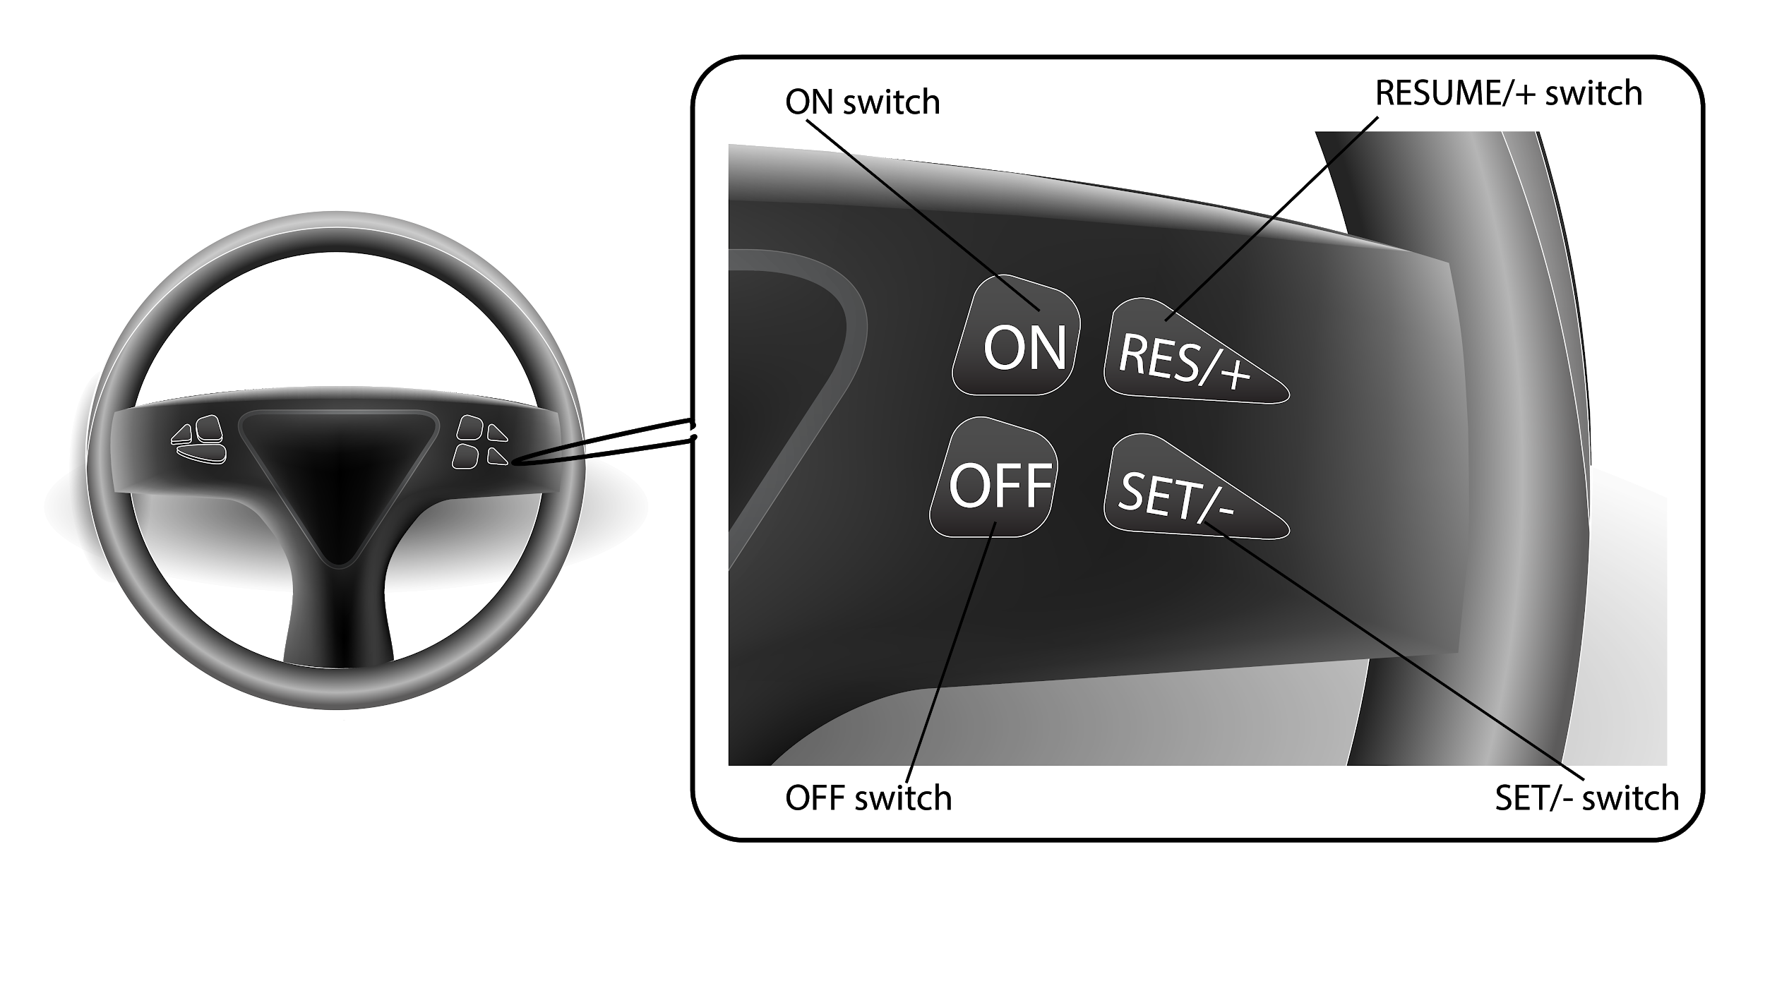

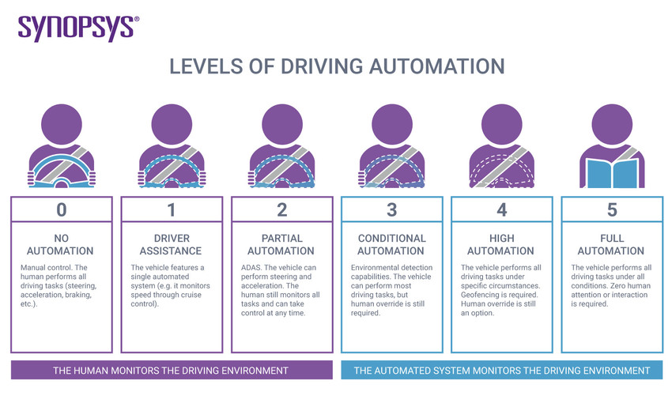
Introduction:
Cruise control is a level 1 feature.
Designed to maintain vehicle speed at a desired set speed value.
Driver sets a desired set speed using the steering inputs and the controller maintains a constant speed of the vehicle.
Notes:
CCR : make image more relevant to the content on left.
Talk only about CC.
Remove third point on acc
Image 1 : steering CC layout : https://lh3.googleusercontent.com/proxy/o5KoCojjwSCysvQImkU8q5HZ1liR3ZHG6r-B9JEEeYnpMxMJYCPIVrWKt3m72vX7xAsOdIQzo_ejuc9J8FV9B24pX3m_8G9DYNlrxXs
Image 2 : global cc symbol: https://s7g10.scene7.com/is/image/volkswagenag/my_car_warning_lights-cruise_control-4_3-2500x1865?Zml0PWNyb3AsMSZmbXQ9anBnJnFsdD03OSZ3aWQ9ODAwJmhlaT02MDAmYWxpZ249MC4wMCwwLjAwJjRiNWM=

Slide 6
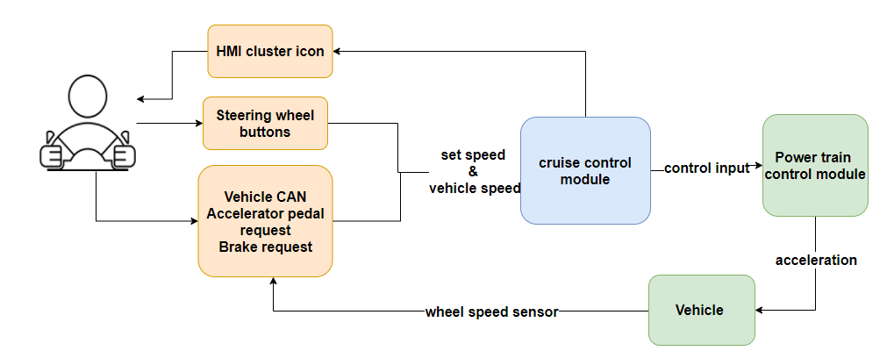
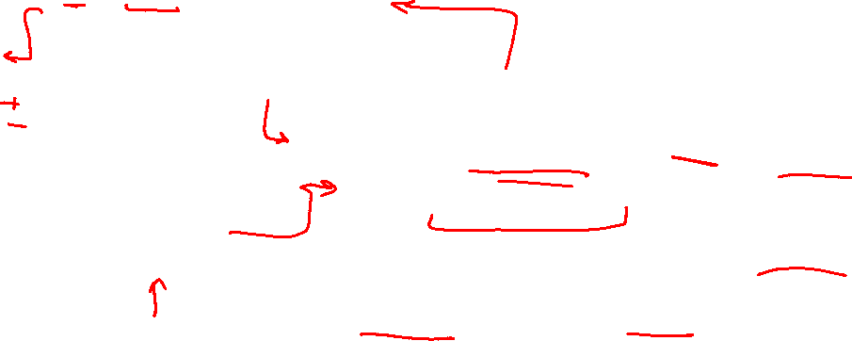
Cruise Control Boundary Diagram:
Notes:
CCR: Remove acc BD
Change the BD to CC BD ; relevant to CC

Slide 7
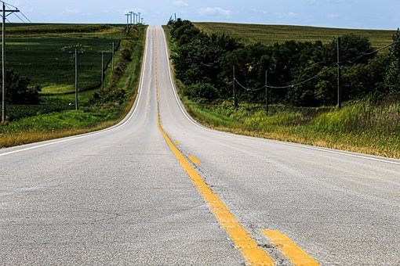
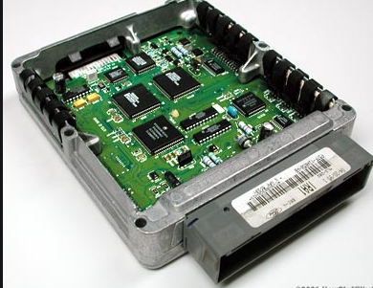
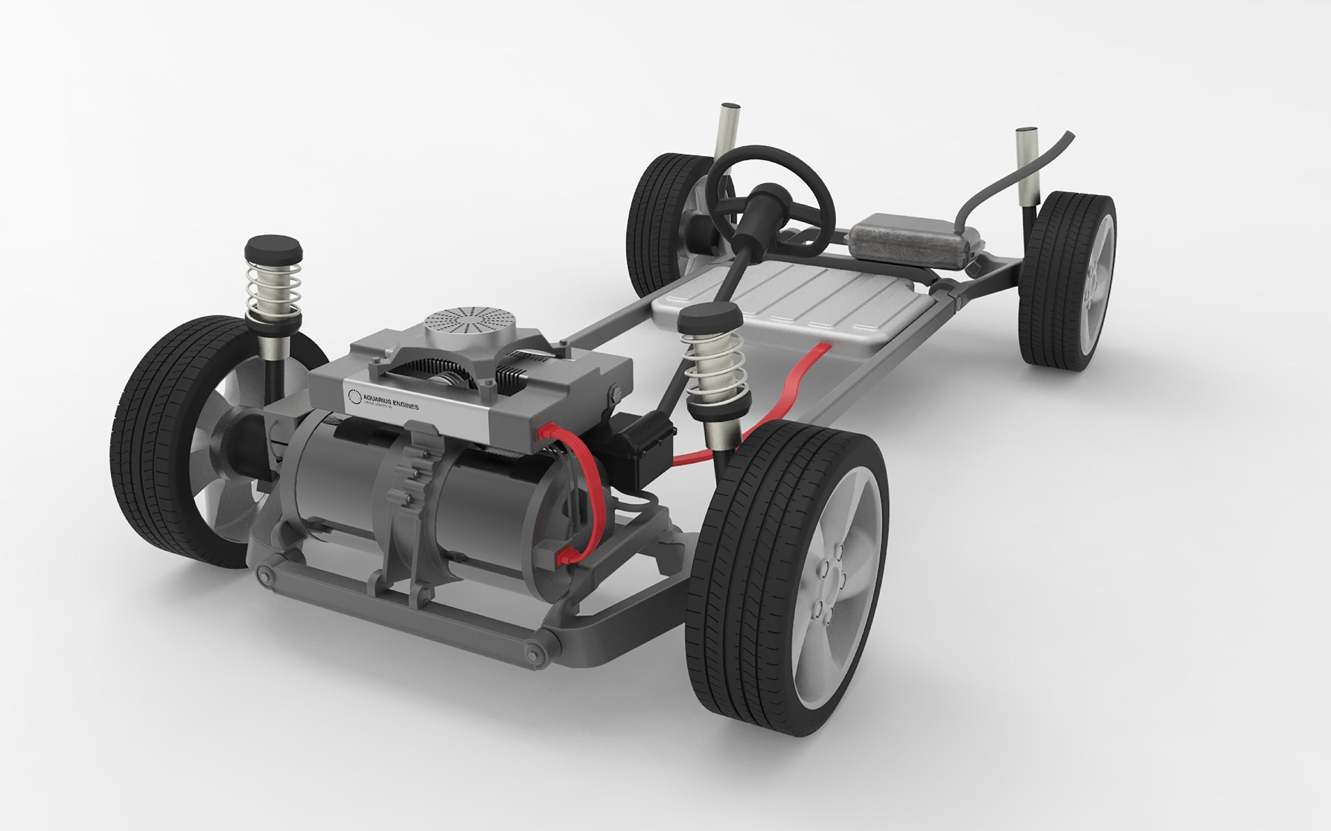
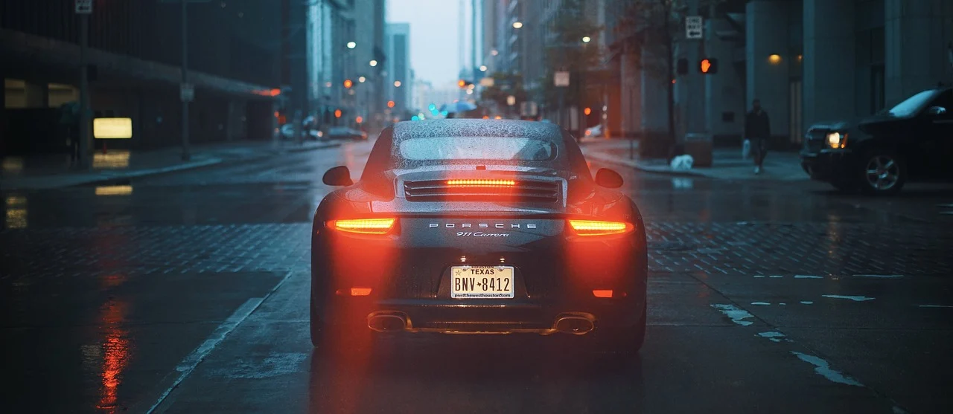

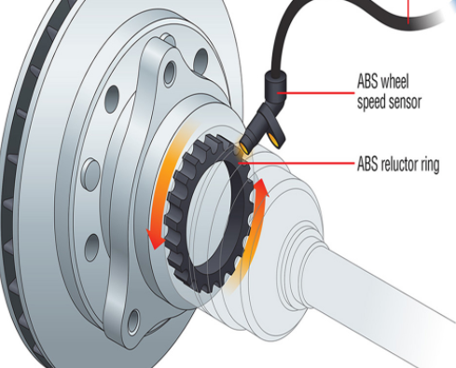
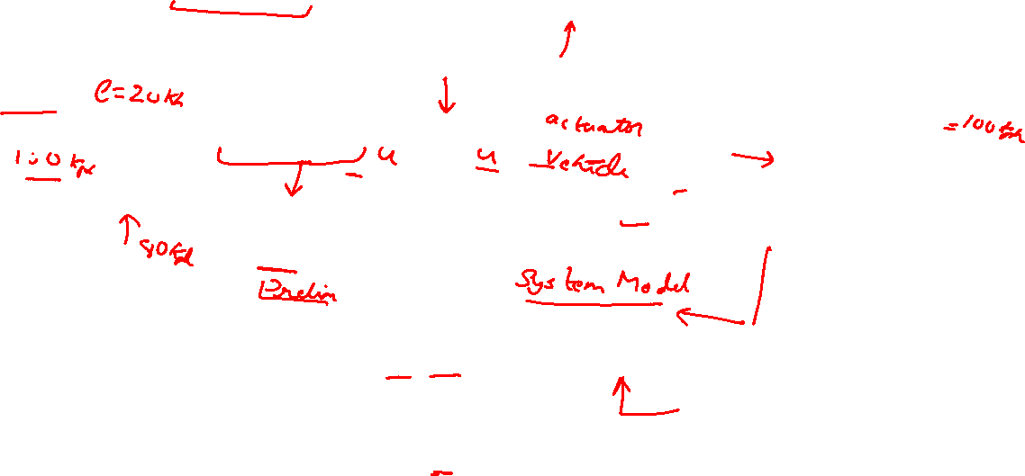
Logic of speed control:
W (disturbance: Eg: hilly roads)
Desired speed
+-
Error
Controller
++
powertrain
Actual output speed
Speed sensor
Notes:
Cr: add images to blocks, change the speedometer to vehicle image with cc set speed.+
Add hilly road to show disturbance
Image 4 : hilly road : https://cdn.pixabay.com/photo/2020/08/29/13/47/road-5527101__340.jpg
Image 1 : CC symbol : https://upload.wikimedia.org/wikipedia/commons/1/15/Cruise_Control.svg
Image 2 : ECUhttps://www.google.com/url?sa=i&url=https%3A%2F%2Fcommons.wikimedia.org%2Fwiki%2FFile%3AMootori_juhtaju.jpg&psig=AOvVaw34Ey9pz7wXsPkcZf2GKgmQ&ust=1608658091306000&source=images&cd=vfe&ved=0CAIQjRxqFwoTCIivlcTM3-0CFQAAAAAdAAAAABAD
Image 3 : powertrain : https://upload.wikimedia.org/wikipedia/commons/5/52/Aquarius_Engines_Series_Hybrid_Powertrain.jpg
Image 4 : wheel speed sensor : https://www.apecbraking.co.uk/getattachment/ce0e7e33-e4b9-4dbd-9161-ba70153a6e90/ABS-Sensors.aspxim
Image 5 : vehicle with set speed: https://www.ford.com/is/image/content/dam/brand_ford/en_us/brand/technology/driver-assist-technology/dm/17_IntellegentACC_Sign_Explorer20.tif?croppathe=1_3x2&wid=900

Slide 8
Longitudinal Vehicle Dynamics

Slide 9

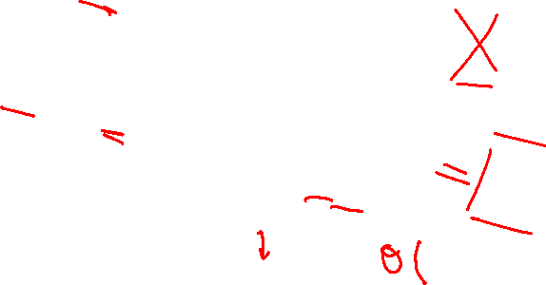
Longitudinal Dynamic Modelling
The forces acting on a car are
Weight
Aerodynamic Drag
Rolling Resistance
Tractive force
Drawbar force
Aero Drag
Drawbar force
Rolling resistance
Traction
Weight
Notes:
S: remove the FBD and show a simple diagram.
Image 1 : car https://pixabay.com/vectors/automobile-car-drive-porsche-1300239/

Slide 10
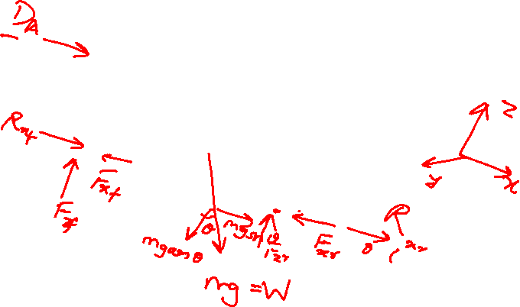
Longitudinal dynamics free body diagram
Notes:
Instructor will draw free body diagram by hand
Image 1 : car https://pixabay.com/vectors/automobile-car-drive-porsche-1300239/

Slide 11
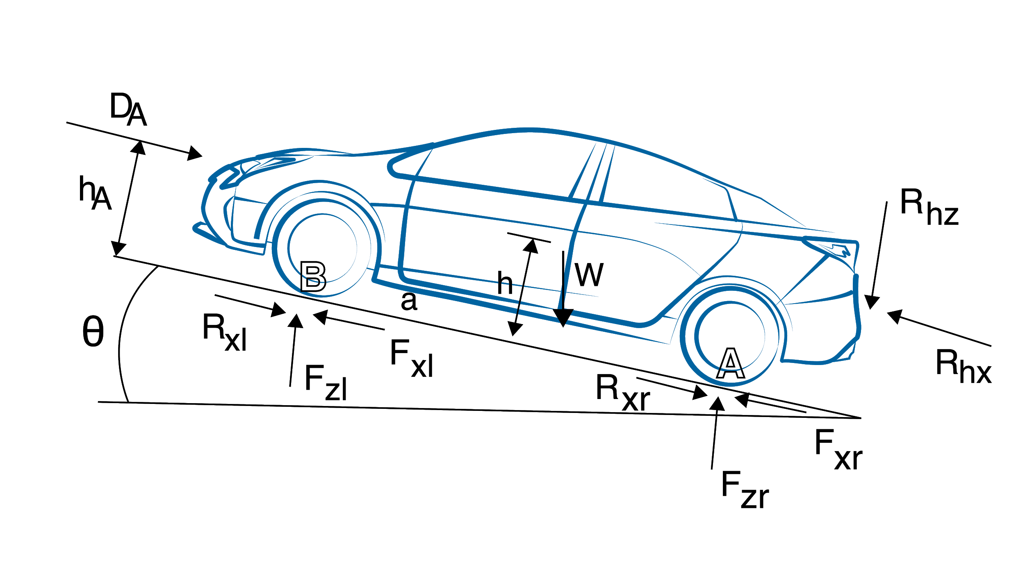
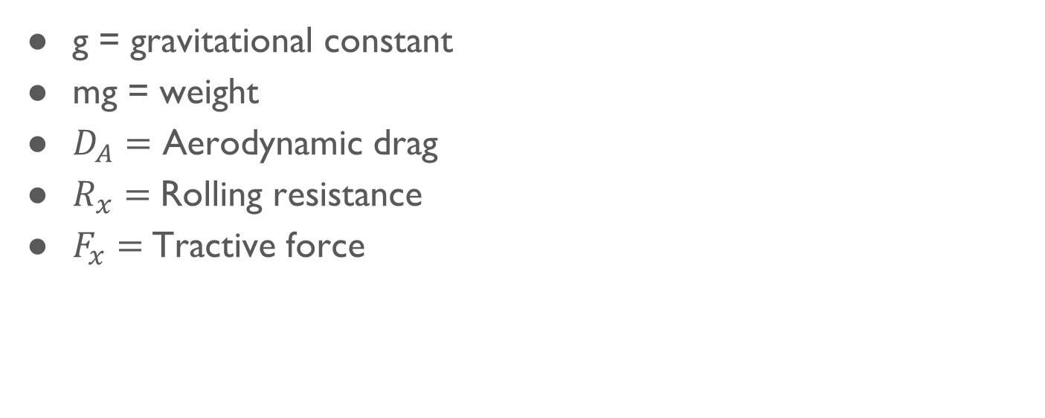
Longitudinal dynamics free body diagram
g = gravitational constant
mg = weight
$D_{A}=$ Aerodynamic drag
$R_{x}=$Rolling resistance
$F_{x}=$Tractive force
Notes:
Labe; the parameter

Slide 12
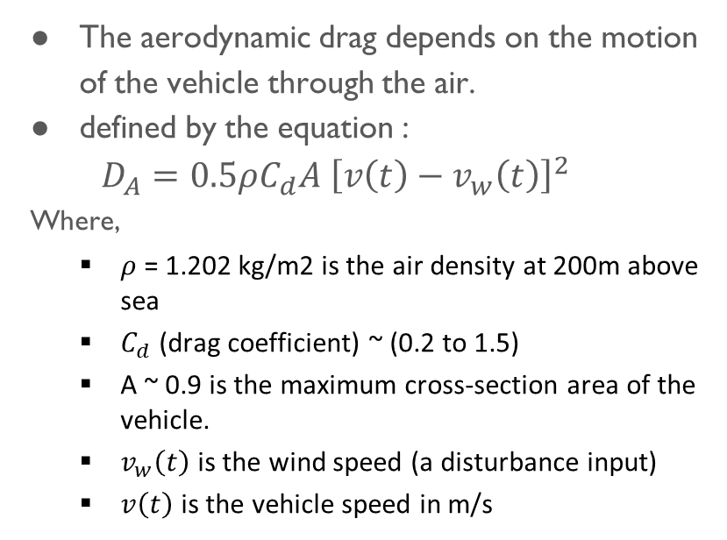
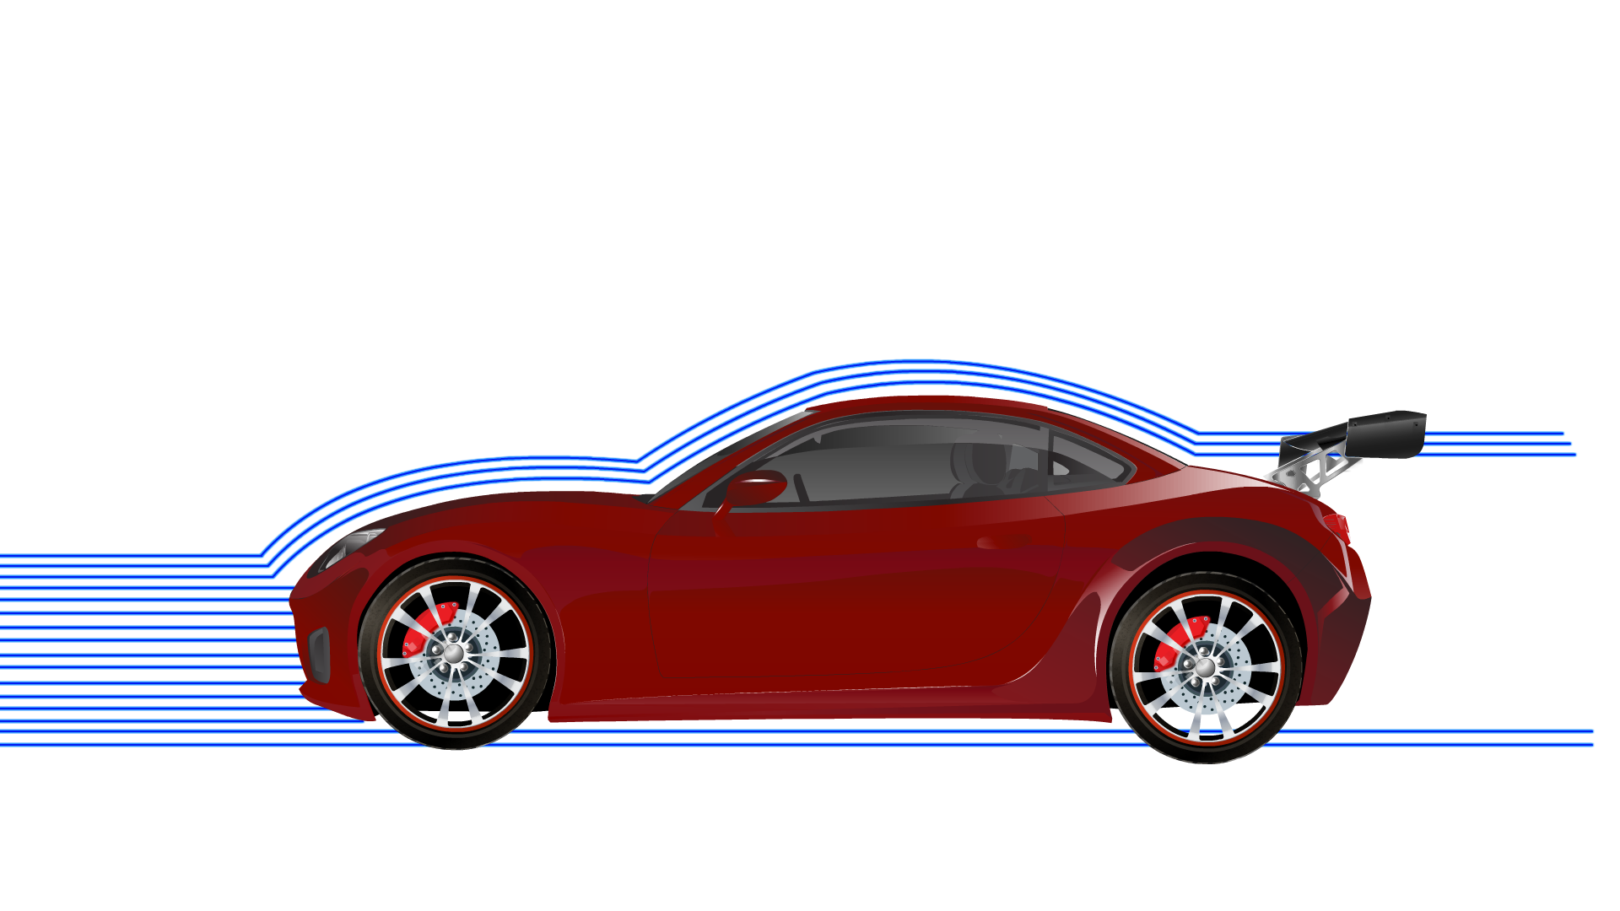
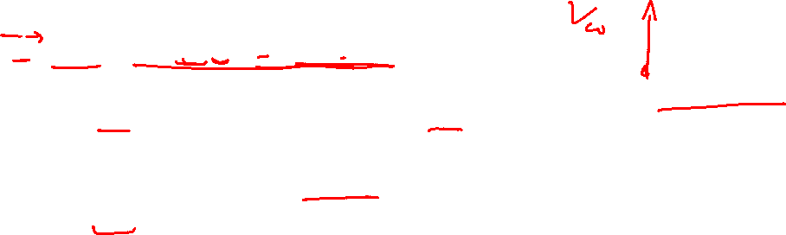
Aerodynamic Drag
Notes:
Image 1 : https://www.autozine.org/technical_school/aero/tech_pic_aero_911.jpg

Slide 13
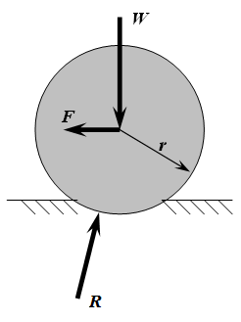
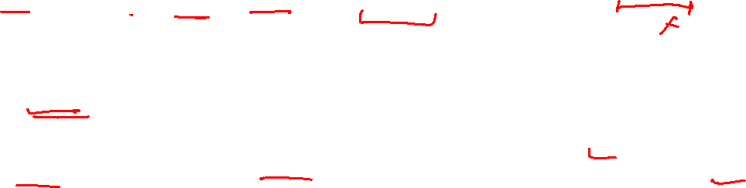
Rolling Resistance
mg
The rolling resistance is roughly proportional to the weight of the vehicle:
𝑅_𝑥 = 𝑅_𝑥𝑓 {𝑓𝑟𝑜𝑛𝑡}+𝑅_𝑥𝑟 {𝑟𝑒𝑎𝑟}~ f * mg
where mg is weight and 𝑓 is friction coefficient.
f~ 0.0125 (varies from 0.01 -0.4)
Rolling resistance is dependent on tire inflation – smaller for higher inflation.

Slide 14
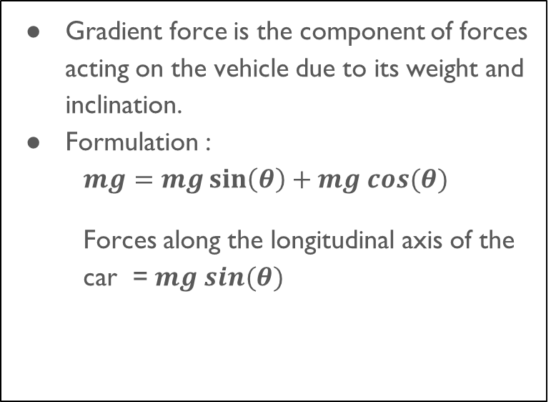
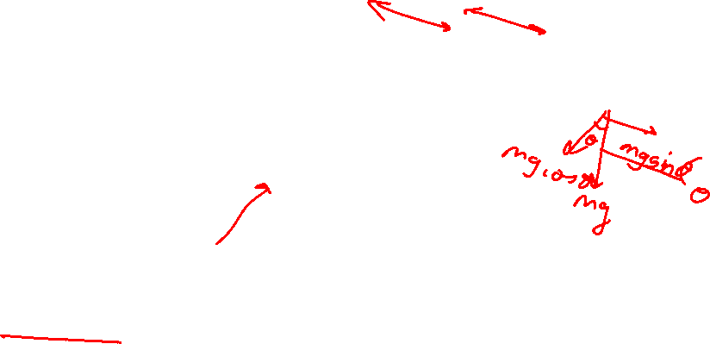
Gradient Force

Slide 15
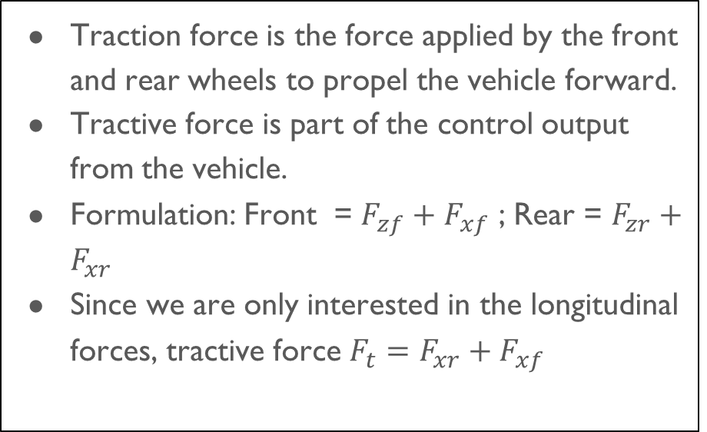
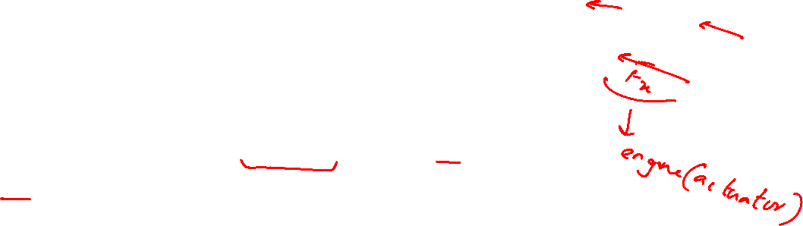
Traction Force

Slide 16
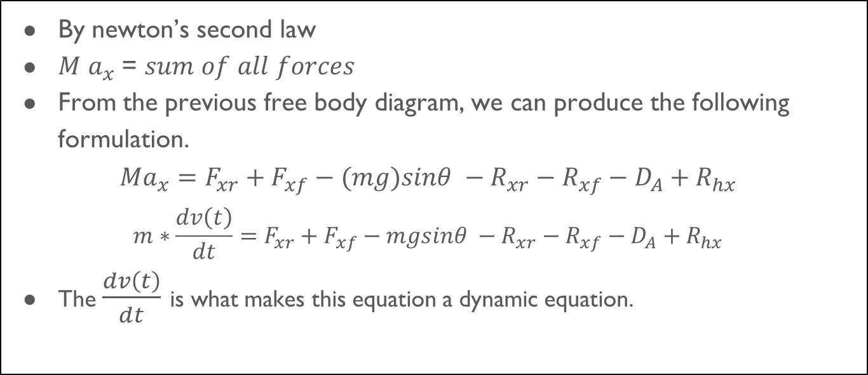
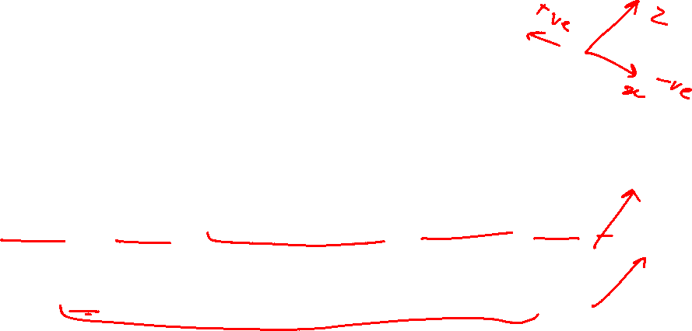
Longitudinal dynamic modeling

Slide 17
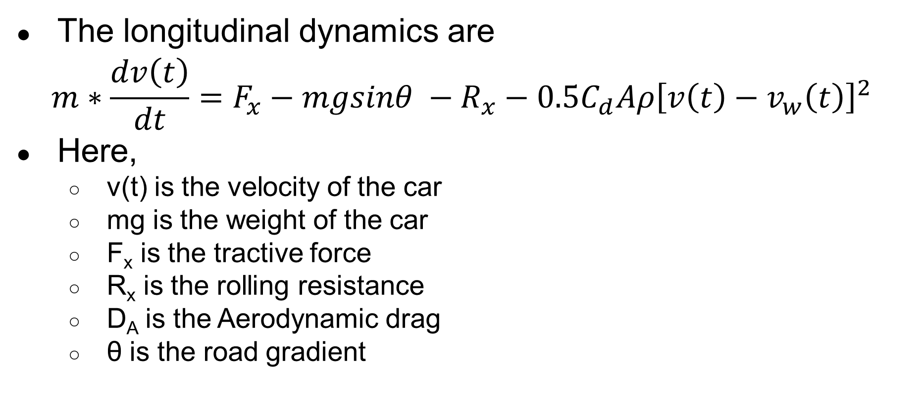
Longitudinal dynamic modeling
The longitudinal dynamics are
$$m∗\frac{dv\left(t\right)}{dt}=F_{x}−mgsinθ −R_{x}−0.5C_{d}Aρ{\left[v\left(t\right)−v_{w}\left(t\right)\right]}^{2}$$
Here,
v(t) is the velocity of the car
mg is the weight of the car
F_{x} is the tractive force
R_{x} is the rolling resistance
D_{A} is the Aerodynamic drag
θ is the road gradient
Notes:
Keep the nomenclature of mass as only m. remove W and use it only as disturbance

Slide 18
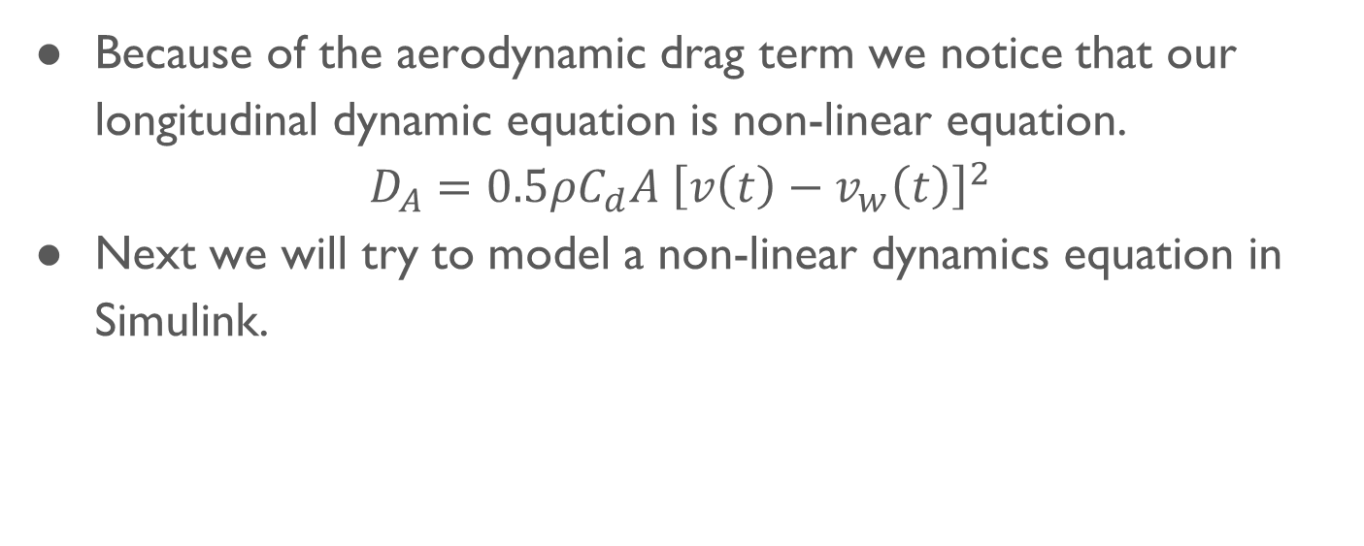

Nature of the dynamic equation

Slide 19
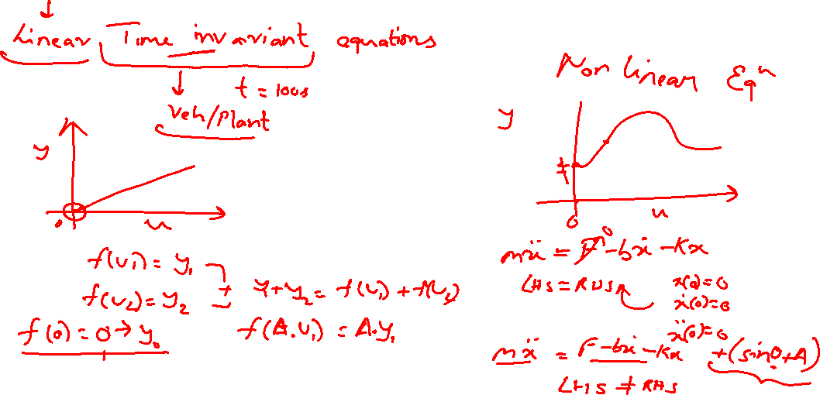
Linear vs Non-linear equation

Slide 20
Non Linear Longitudinal modeling

Slide 21
Model Parameters
Model parameters | values
Mass (m) | 1084 kg
Gravitation accel constant (g) | 9.81 mpss
Drag coefficient (Cd) | 0.3
Rolling coefficient (f) | 0.0125
Initial velocity V0 | 27.8mps
Wind velocity | 1.2mps
Area of cross section (A) | 2.24 m2

Slide 22
Non-linear longitudinal model

Slide 23
Longitudinal modeling for control systems

Slide 24
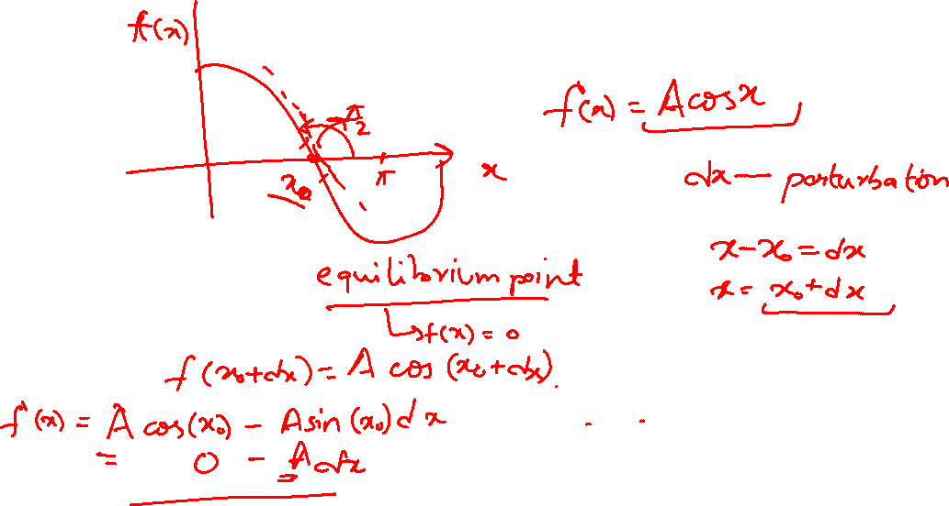

Slide 25
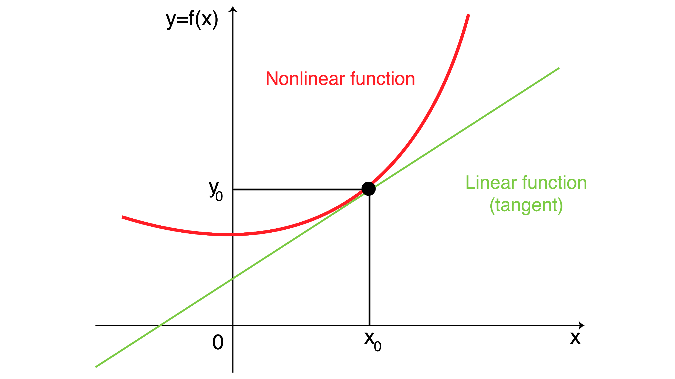
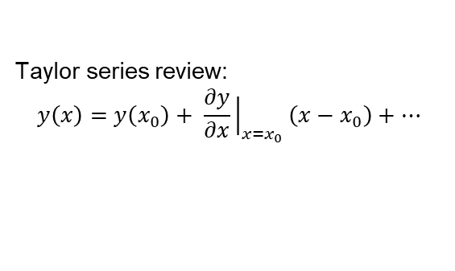
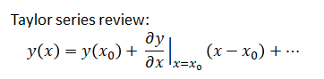
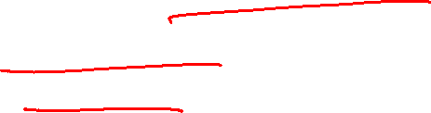
Linearizing a function
Difficult to solve nonlinear functions but all systems in reality are non linear in nature.
Using Taylor’s series expansion, we can approximate a nonlinear function as a linear function.

Slide 26
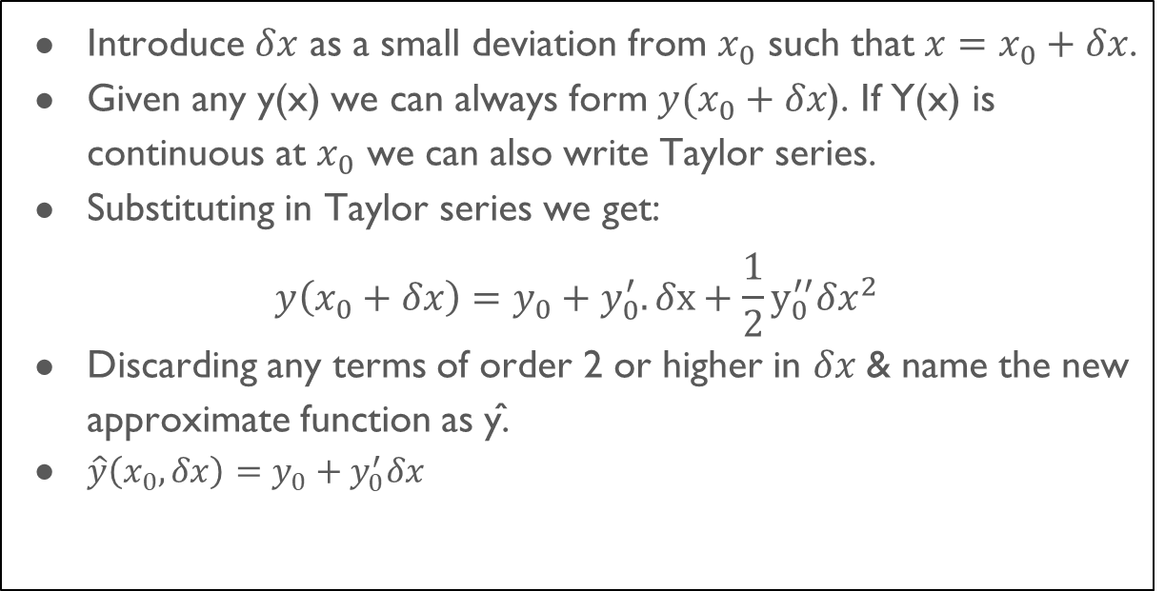
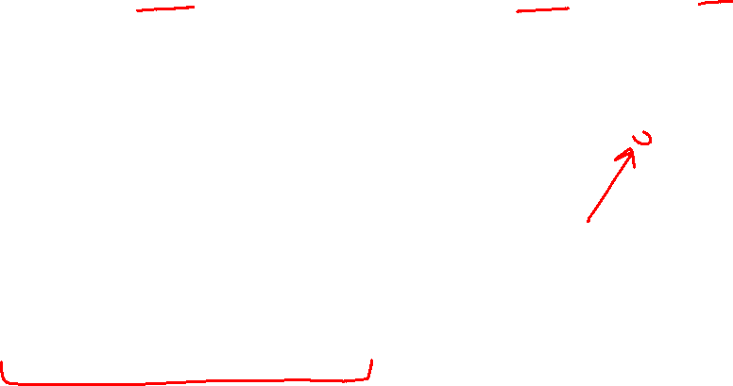
Steps for Linearizing using Taylor’s expansion

Slide 27
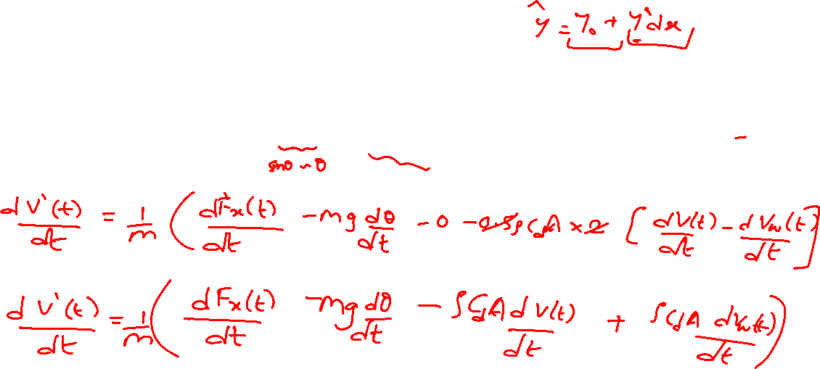
Linearizing the longitudinal model
The combined longitudinal dynamics equations can be written as:

Slide 28
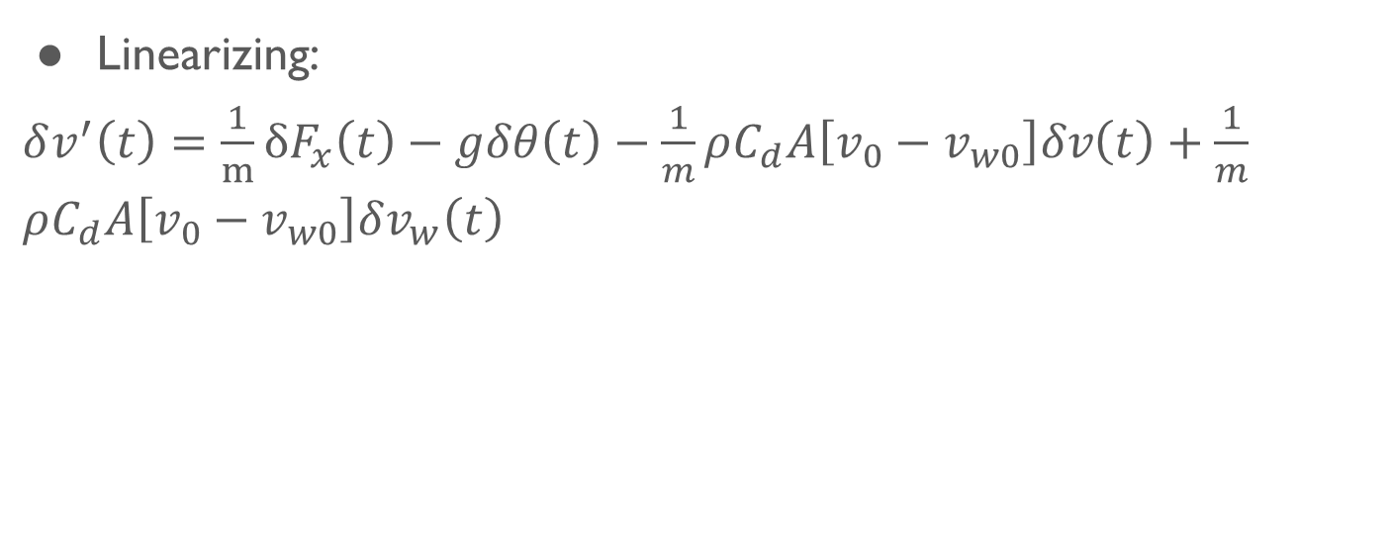
Linearized longitudinal dynamic equation

Slide 29
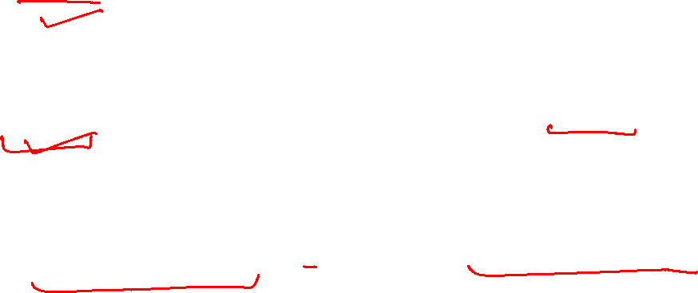
Controller plant model
Linearized model
Taking laplace transform of the longitudinal dynamics
Reducing the laplace transform

Slide 30
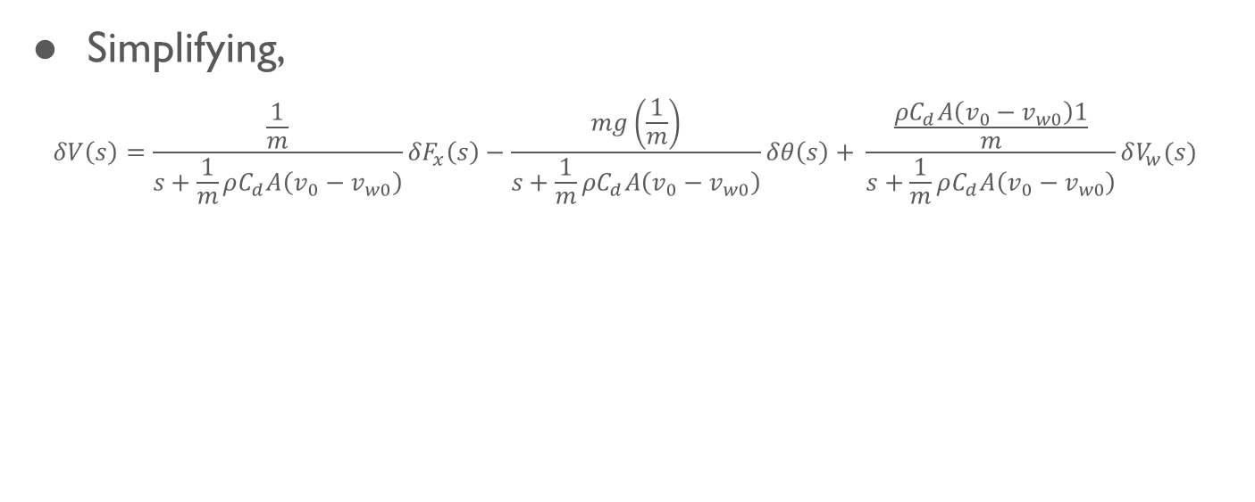
Plant model

Slide 31
Linearized model in Simulink

Slide 32
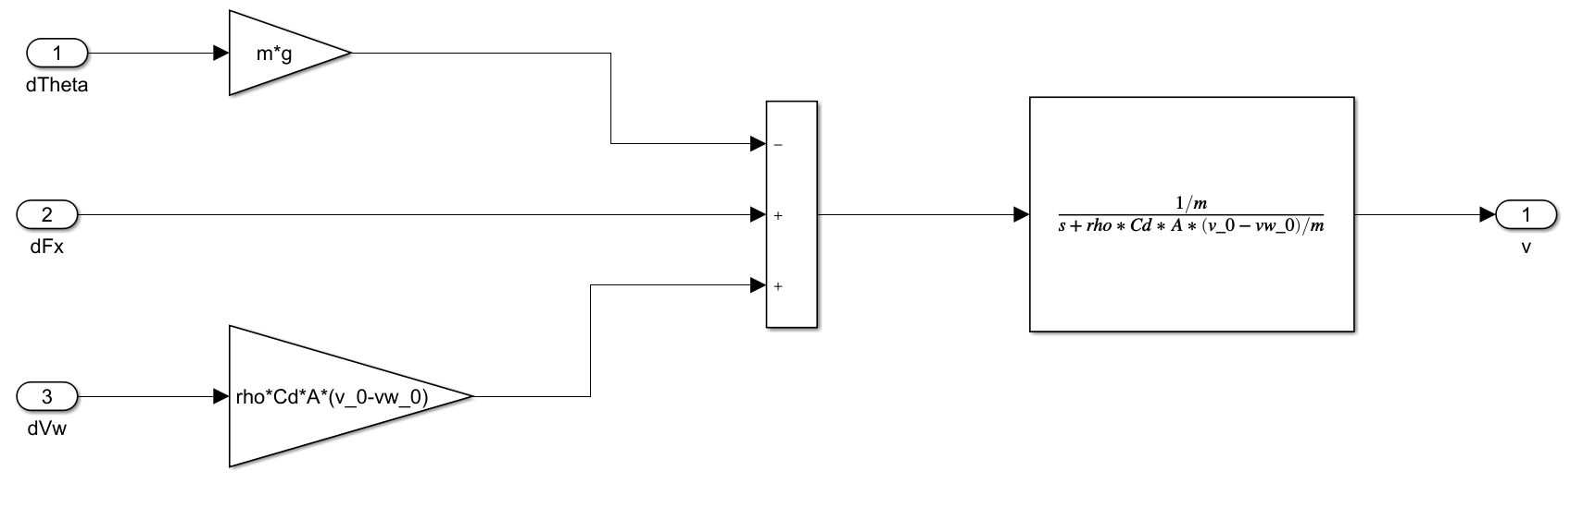
Linearized model in Simulink

Slide 33


Linearized plant model response

Slide 34
Controller design

Slide 35
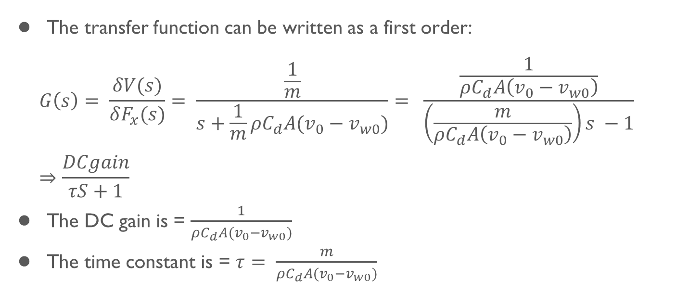
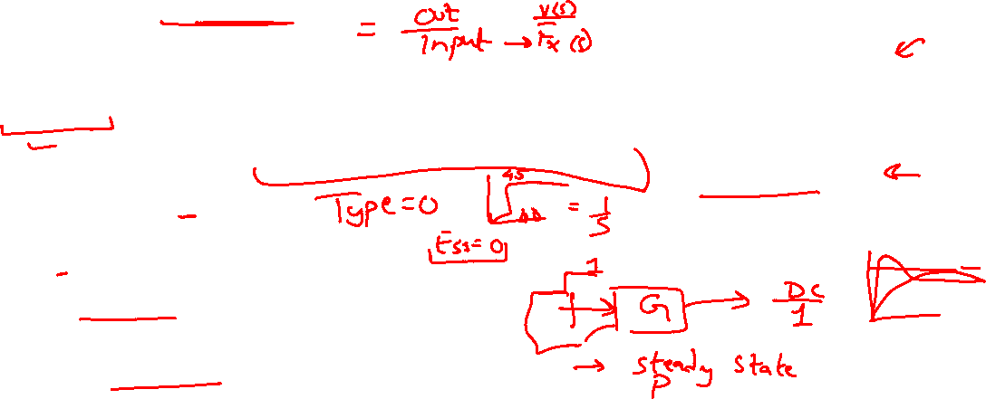
Plant model or transfer function
The transfer function can be written as a first order:
$$G\left(s\right)= \frac{δV(s)}{δF_{x}(s)}= \frac{\frac{1}{m}}{s+\frac{1}{m}ρC_{d}A(v_{0}−v_{w0})}= \frac{\frac{1}{ρC_{d}A\left(v_{0}−v_{w0}\right)}}{\left(\frac{m}{ρC_{d}A\left(v_{0}−v_{w0}\right)}\right)s −1}⇒\frac{DCgain}{τS+1}$$
The DC gain is = $\frac{1}{ρC_{d}A(v_{0}−v_{w0})}$
The time constant is = $τ= \frac{m}{ρC_{d}A(v_{0}−v_{w0})}$

Slide 36
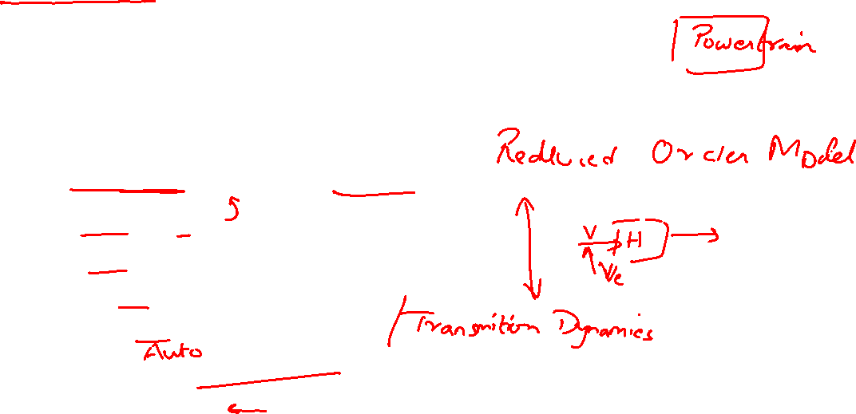
Total model for cruise control model system
The total cruise system has throttle command as input.
This input will go into:
Throttle dynamic or Motor dynamics
Air dynamics
Fuel dynamics
Engine rotation dynamics
Torque converter Dynamics
Power train transmission dynamics
What a mess!

Slide 37
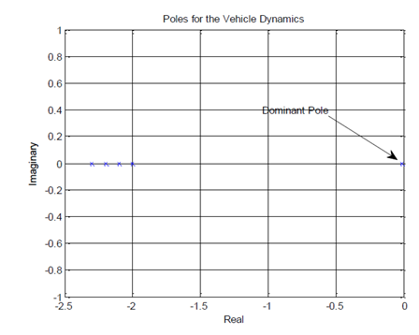
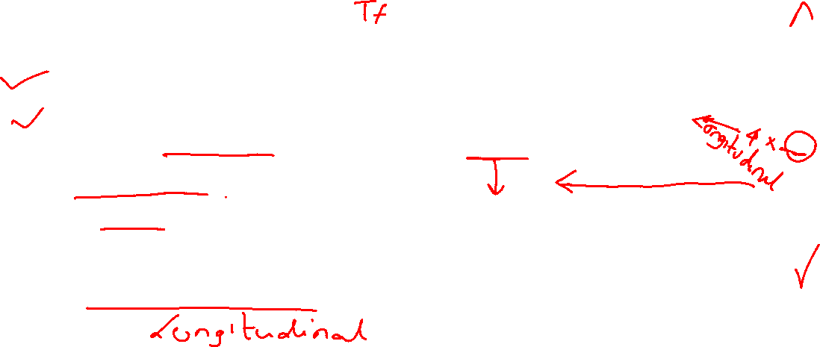
Reduced order model
For transient models
Dominant poles are of concern
Dominant poles are zeroes and closer to imaginary axis
Non dominant poles> 4 times dominant pole.
For our control system,
Ignore non-dominant poles

Slide 38
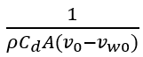
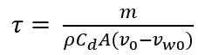
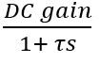
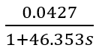
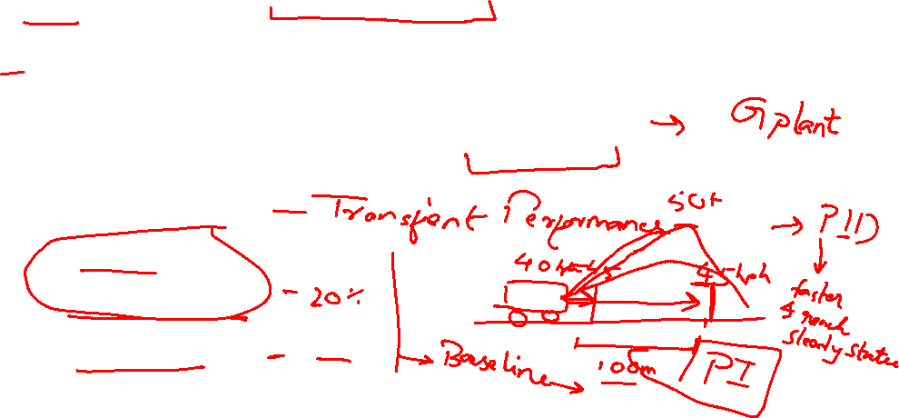
Model Parameters
DC gain = H(0)=1/(ρC_d A(v = 0.0427 (m/s)/N
= 46.353s
Transfer function = (DC gai= 0.0
Design criteria :
Rise time <12s
Overshoot <10%
Steady state error <2%

Slide 39

Controller Design

Slide 40
results
Without disturbance
with disturbance

Slide 41
Summary:
Cruise control
Longitudinal Vehicle Dynamic modelling
Controller design for base cruise
Challenge
Cruise control with speed limits
Modify model to account sensor noise
Notes:
Source: https://media.springernature.com/original/springer-static/image/chp%3A10.1007%2F978-1-4614-1433-9_4/MediaObjects/82912_2_En_4_Fig6_HTML.gif
https://mediacloud.carbuyer.co.uk/image/private/s--nTU5yrhV--/v1579621590/carbuyer/cc1_0.jpg

Slide 42
THANK YOU

